Slide 1

From Boo to Boo Hoo:
Dissecting the circuits involved in the shift from transient to chronic fear
Presented by: Jazmine Yaeger

Slide 2






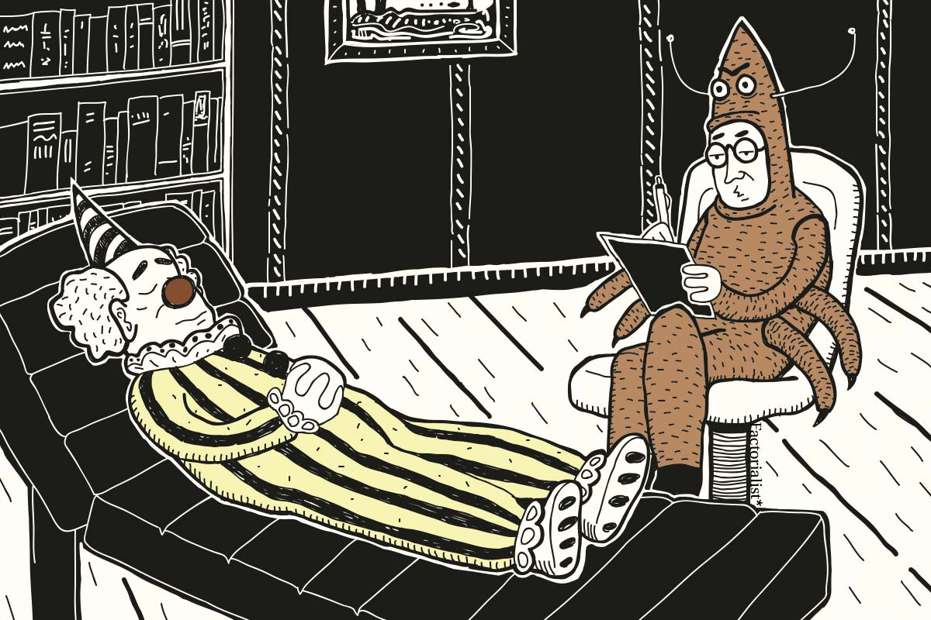



Contemplating a Fear/Anxiety Gradient...
LESS
MORE

Slide 3
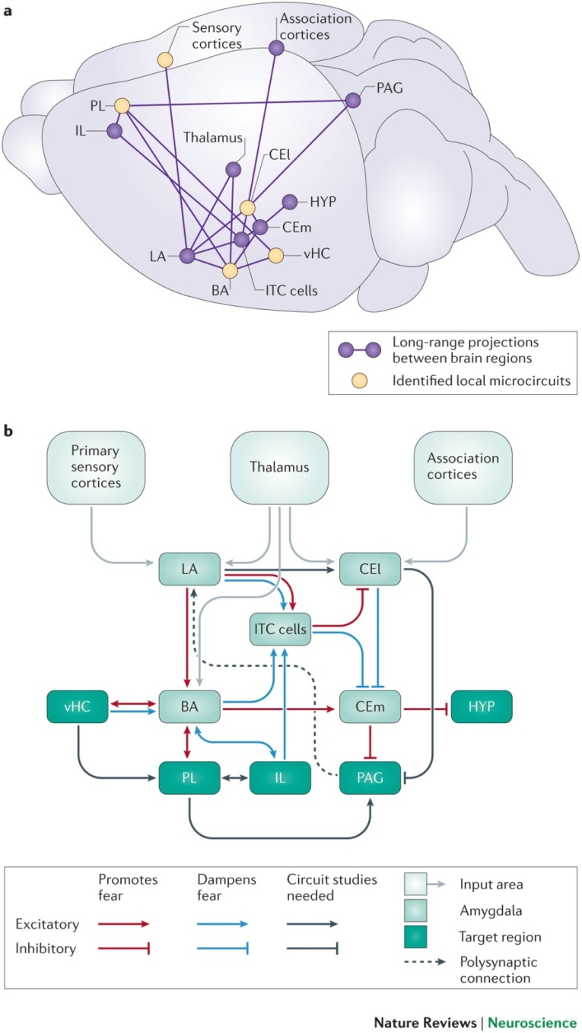
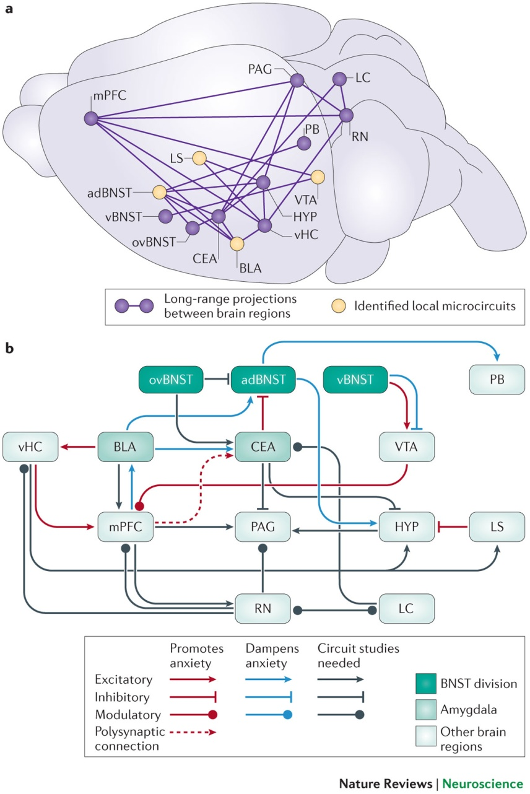
Considerations Regarding Fear Circuitry...
Are fear and anxiety physiologically different?
Fear Circuitry
Anxiety Circuitry
Tovote, P., et al. (2015). "Neuronal circuits for fear and anxiety." Nature Reviews. Neuroscience 16(6): 317.

Slide 4
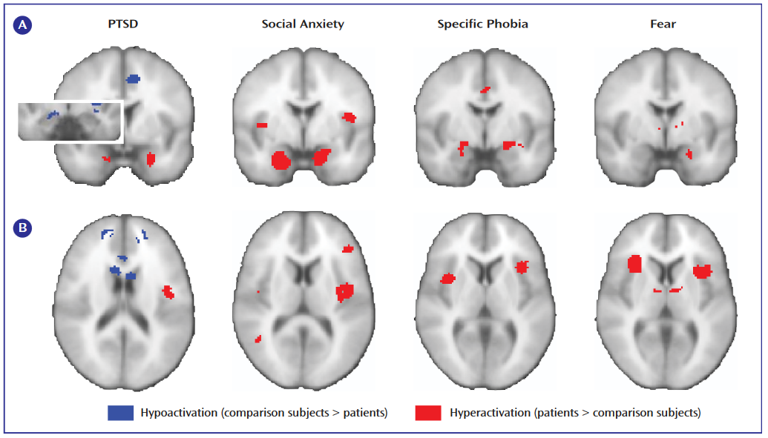
Considerations Regarding Fear Circuitry...
Are fear and anxiety physiologically different?
Is social stress different from generalized stress?
Etkin, A. and T. D. Wager (2007). "Functional neuroimaging of anxiety: a meta-analysis of emotional processing in PTSD, social anxiety disorder, and specific phobia." American Journal of Psychiatry 164(10): 1476-1488.

Slide 5


Considerations Regarding Fear Circuitry...
Are fear and anxiety physiologically different?
Is social stress different from generalized stress?
Does unpredictability make a difference?
  PTSD^{1,2}
  Depression³/Anhedonia⁴
Başoğlu, M. and S. Mineka (1992). "The role of uncontrollable and unpredictable stress in post-traumatic stress responses in torture survivors.“
Foa, E. B., et al. (1992). "Uncontrollability and unpredictability in post-traumatic stress disorder: an animal model." Psychological bulletin 112(2): 218.
Willner, P. (1997). "Validity, reliability and utility of the chronic mild stress model of depression: a 10-year review and evaluation." Psychopharmacology 134(4): 319-329.
Papp, M., et al. (1991). "An animal model of anhedonia: attenuation of sucrose consumption and place preference conditioning by chronic unpredictable mild stress." Psychopharmacology 104(2): 255-259.

Slide 6
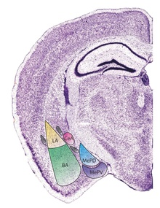
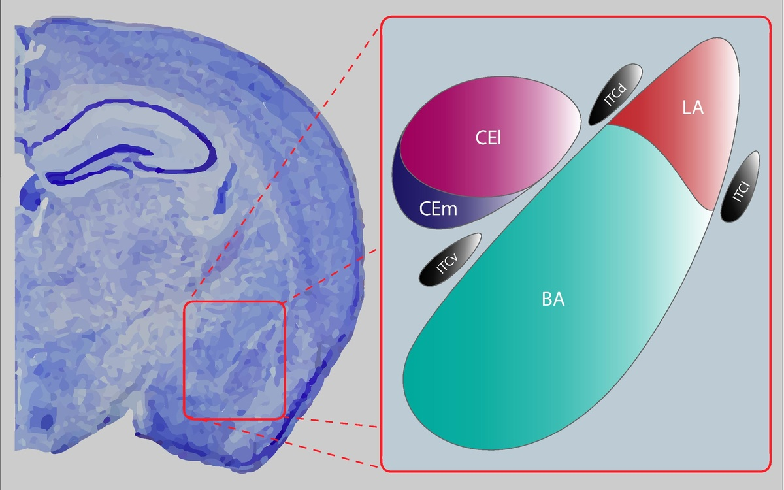
No Matter What...The Amygdala is Involved...

Slide 7
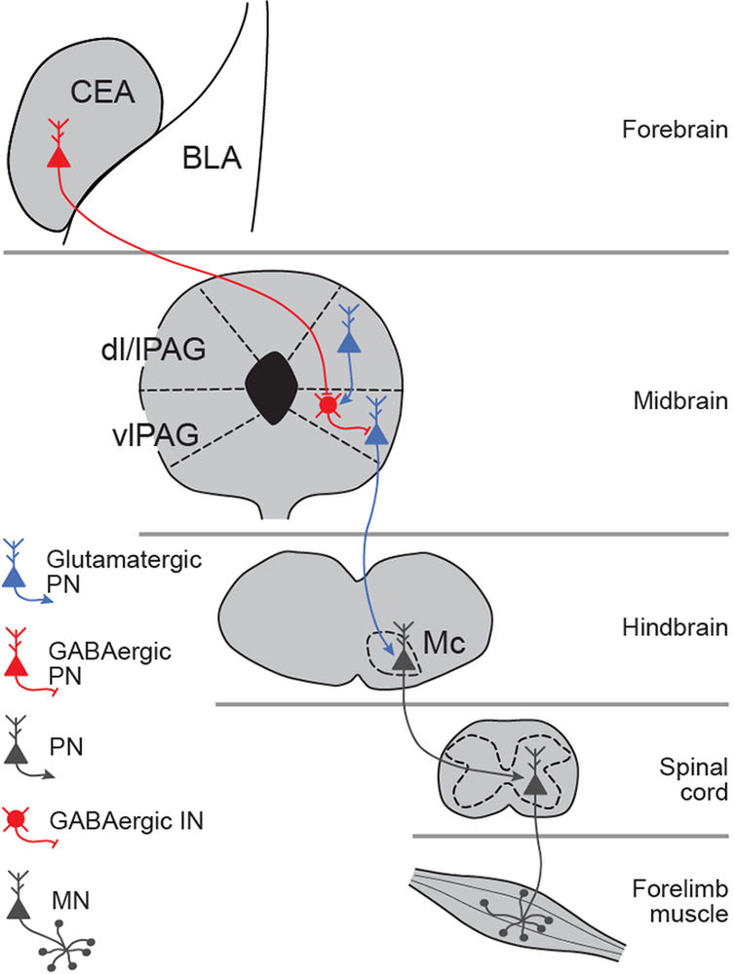
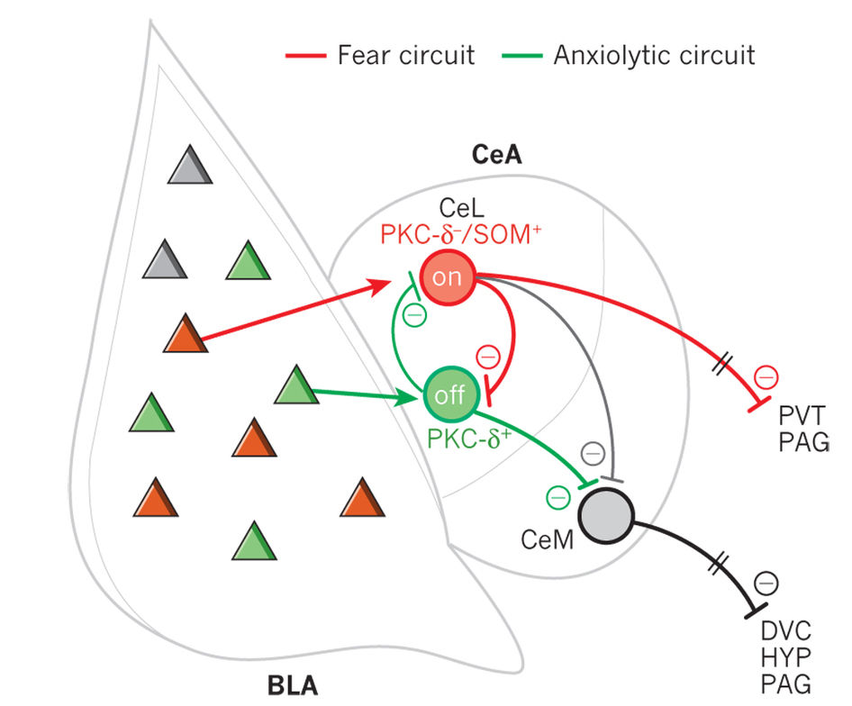
No Matter What...The Amygdala is Involved...
Janak, P. H. and K. M. Tye (2015). "From circuits to behaviour in the amygdala." Nature 517: 284.

Slide 8
No Matter What...The Amygdala is Involved...
Glu
IL
mPFC
CeA
PrL
EC
lCeA
PAG
Glu
lcCeA
Glu
“Off”
mCeA
dl/lPAG
Mc
LA
“On”
Glu
mpITC
GABA
GABA
lpITC
GABA
GABA
Glu
ACh
Glu
GABA
vlPAG
GABA
Glu
ACh
SC
GABA
BLA
HYPOTHALAMUS
Anxious &
Depressive
Behaviors

Slide 9
No Matter What...The Amygdala is Involved...
Glu
IL
mPFC
CeA
PrL
EC
lCeA
PAG
Glu
lcCeA
Glu
“Off”
mCeA
dl/lPAG
Mc
LA
“On”
Glu
mpITC
GABA
GABA
lpITC
GABA
GABA
Glu
ACh
Glu
GABA
vlPAG
GABA
Glu
ACh
SC
GABA
BLA
HYPOTHALAMUS
Anxious &
Depressive
Behaviors

Slide 10

No Matter What...The Amygdala is Involved...
alBNST
IL
GABA
Glu
Glu
mPFC
CeA
PrL
EC
lCeA
PAG
Glu
lcCeA
Glu
“Off”
mCeA
dl/lPAG
Mc
LA
“On”
Glu
mpITC
GABA
GABA
lpITC
GABA
GABA
Glu
ACh
Glu
GABA
vlPAG
GABA
Gu
ACh
SC
GABA
BLA
HYPOTHALAMUS
Anxious &
Depressive
Behaviors
Puente, N., Elezgarai, I., Lafourcade, M., Reguero, L., Marsicano, G., Georges, F., ... & Grandes, P. (2010). Localization and function of the cannabinoid CB1 receptor in the anterolateral bed nucleus of the stria terminalis. PloS one, 5(1), e8869.

Slide 11

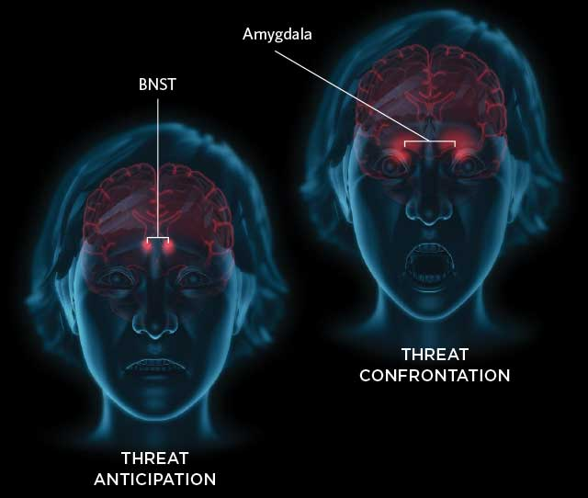
A Brief Recap...
The expression of fear/anxiety is likely graded response
And...
The amygdala (and BNST) appear to be important
But...
Is there a neurophysiological switch that triggers a fearful stimuli to produce a prolonged response?

Slide 12

The Answer is...Maybe...
Cannabinoid Cb1 receptors in distinct circuits of the extended amygdala determine fear responsiveness to unpredictable threat
Lange et al. 2017

Slide 13
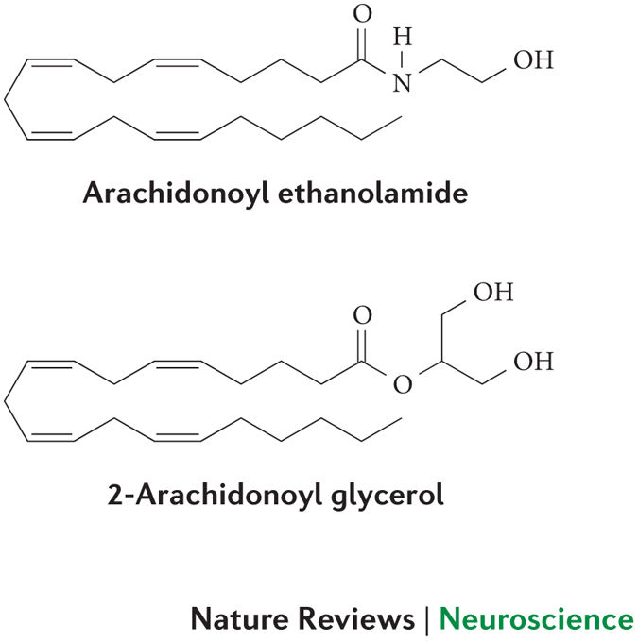
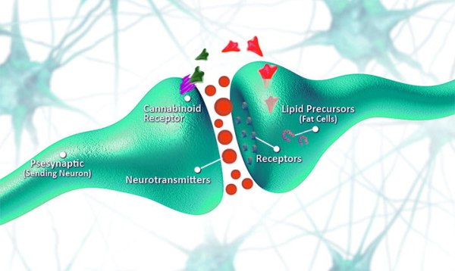
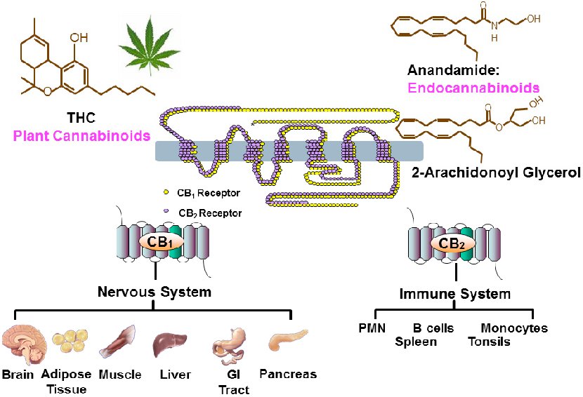
A Brief Introduction to Endocannabinoids...
Lipid-based neuromodulators
Move in a retrograde manner to inhibit presynaptic cell
Bind to one of two receptors
  Cb1
  Cb2
  THC can bind here too
Mechoulam, R., et al. (2014). "Early phytocannabinoid chemistry to endocannabinoids and beyond." Nature Reviews Neuroscience 15: 757.
Pryce G, Baker D. Potential control of multiple sclerosis by cannabis and the endocannabinoid system. CNS Neurol Disord Drug Targets 11: 624-641.

Slide 14
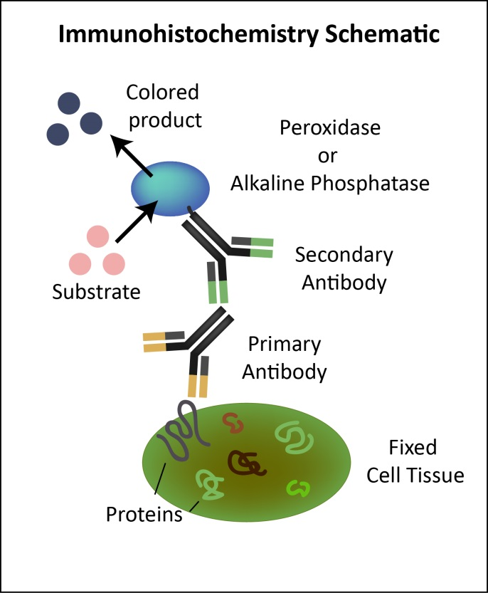
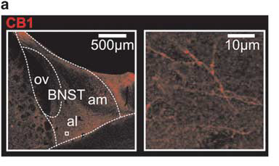
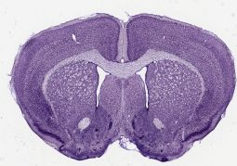
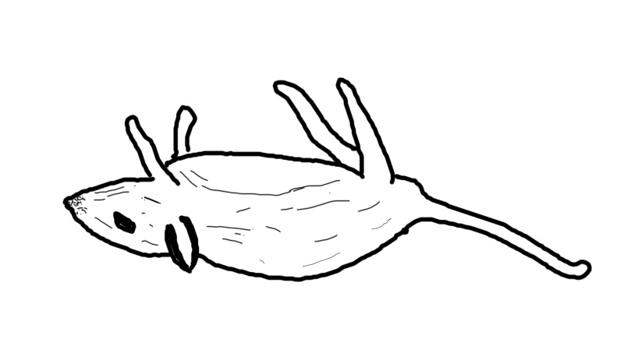
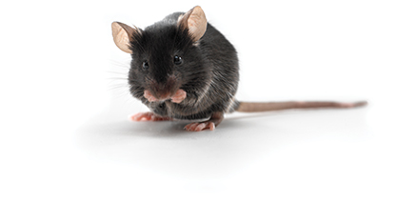
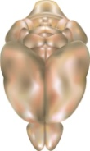
Where Might The Endocannabinoids be Working in The Fear Circuit?

Slide 15

So...An abundance of Cb1 Receptors are present in the Anterior BNST...
But how do these Cb1 receptors influence fear behavior?

Slide 16
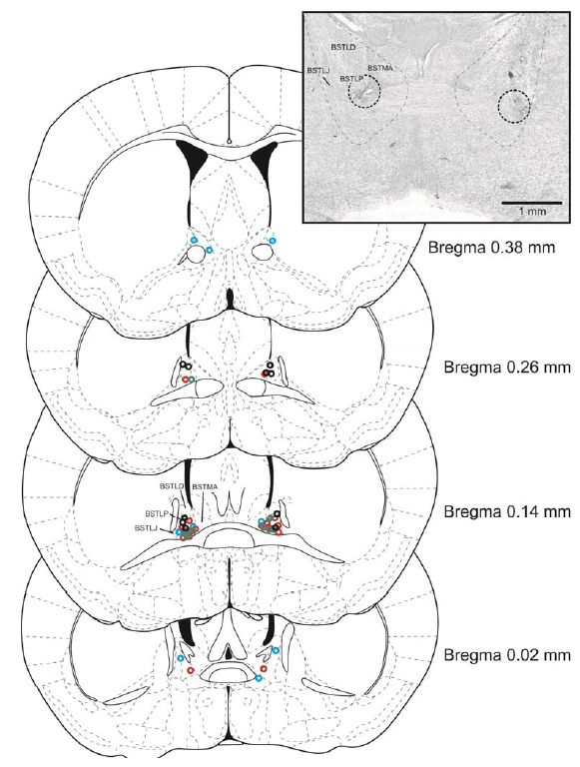
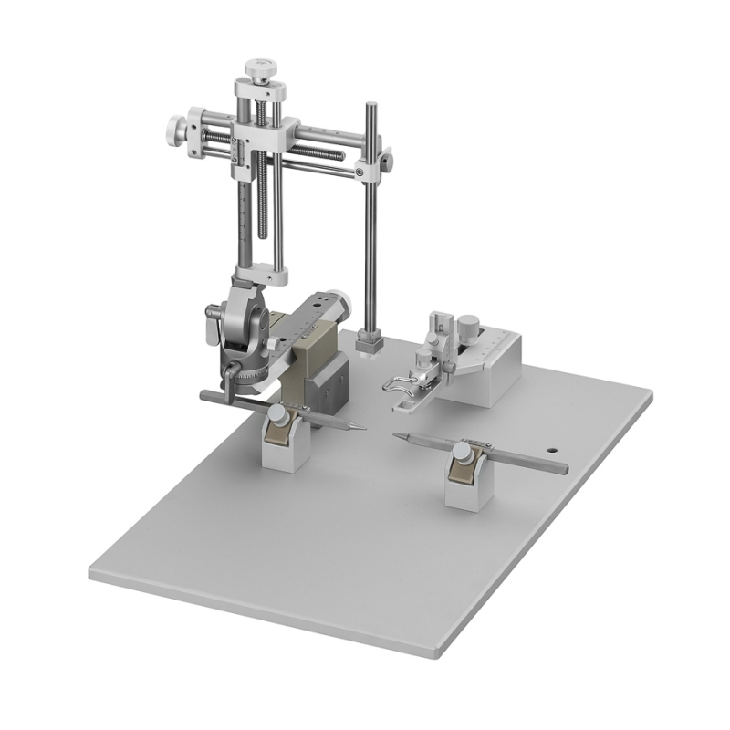
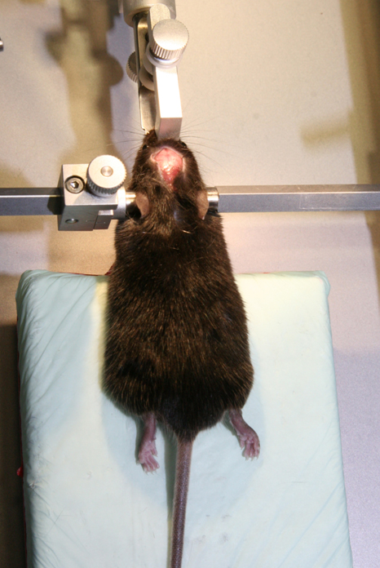
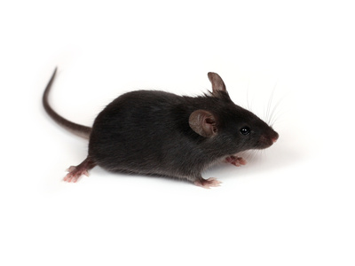
Stereotaxic Surgery...

Slide 17

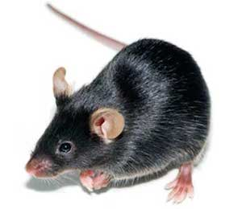
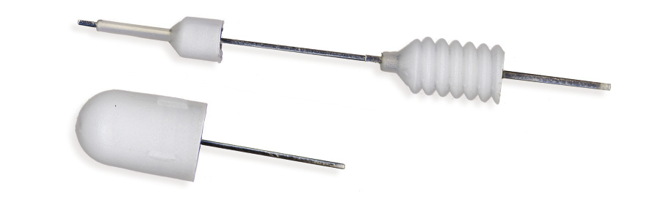
The Fear Paradigm...

Slide 18


The Fear Paradigm...
Control Mice = Predictable Tone

Slide 19

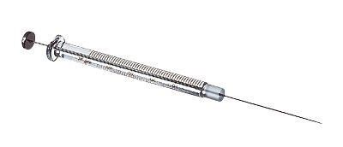
The Fear Paradigm...
AM251 – 15 min before behavioral testing
Freezing time measured during tone
6 min

Slide 21
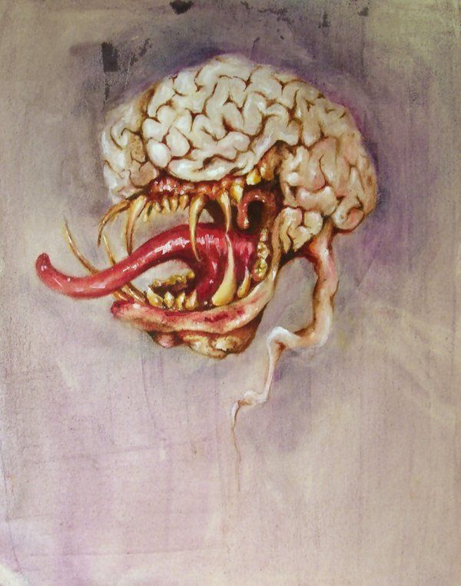
So...Blocking CB1 receptors in the BNST Shifts behavior to a Phasic Fear Response...
But...On which connections are the Cb1 receptors located?

Slide 22

Stereotaxic Surgery...
Amygdalar Targets Unilaterally –
AAV₆-Syn-hChR(H134R)-eYFP
5-7 Weeks

Slide 23
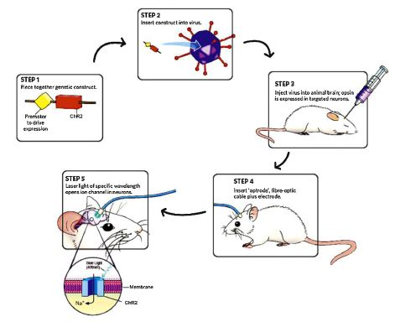
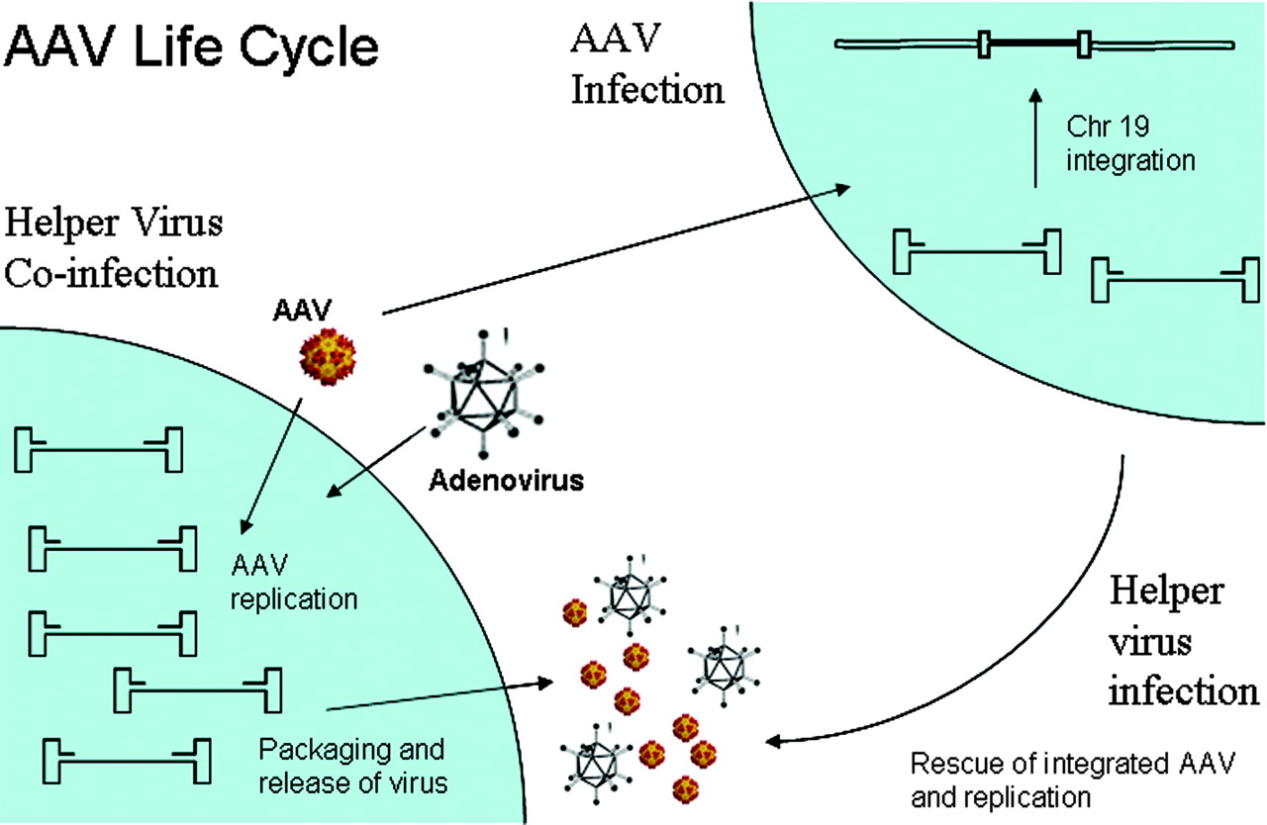
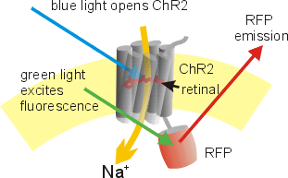
A Brief Description of Optogenetics...
AAV₆-Syn-hChR(H134R)-eYFP
AAV₆ – Viral Vector
  Adeno-associated virus – Serotype 6
  Infects neurons
Syn – Promoter
  Synapsin promoter
  Synapsin protein is involved in vesicular release of neurotransmitters
  Found in all neurons
hChR(134R) – Light-activated channel construct
  Channelrhodopsin
eYFP – Fluorescent protein marker
  Yellow Fluorescent Protein

Slide 24
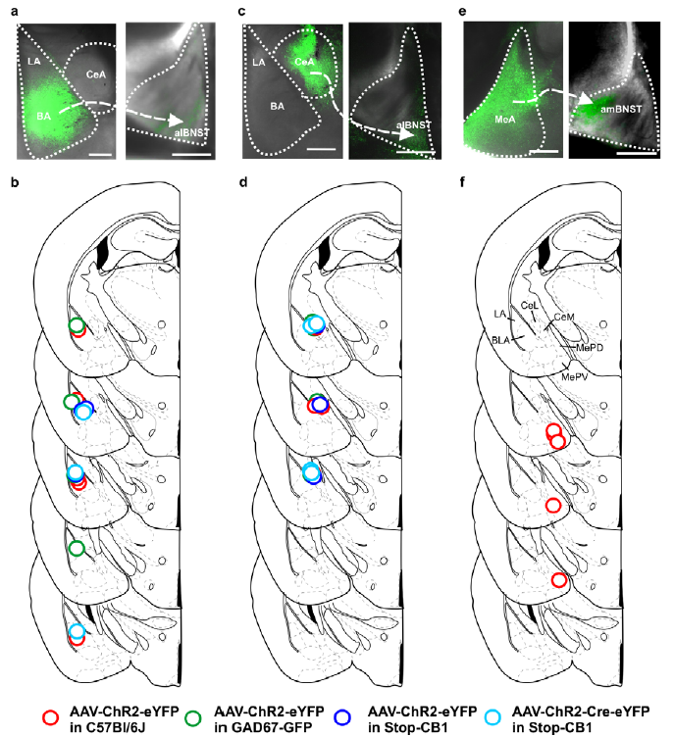

Slide 25
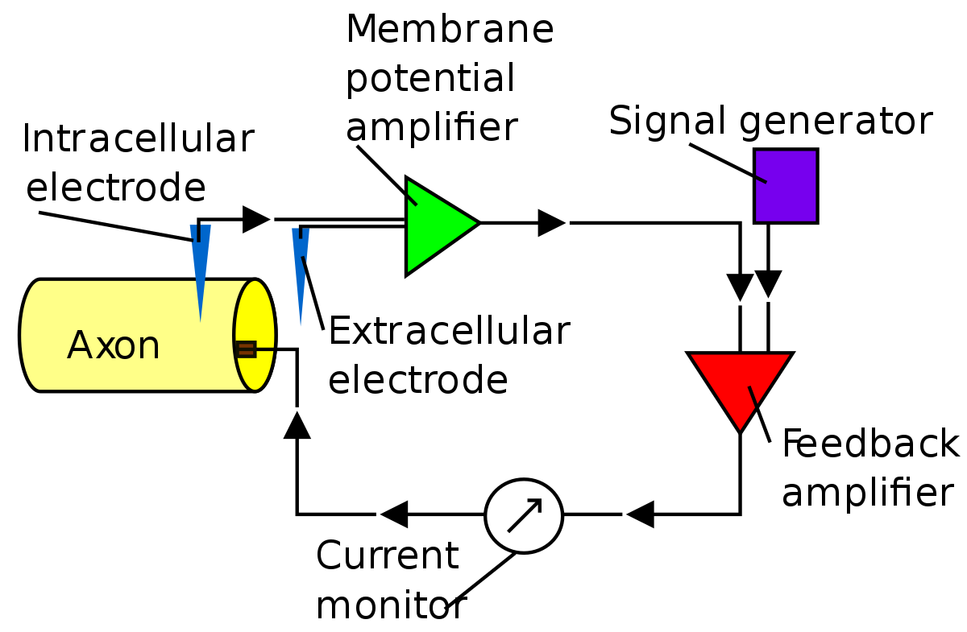
A Brief Description of Electrophysiology...

Slide 26
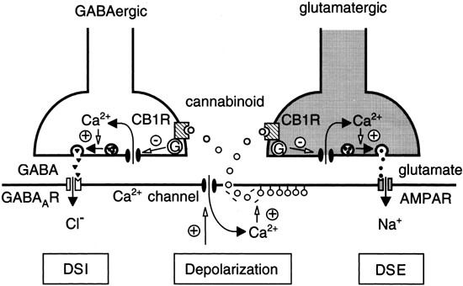
A brief explanation…
DSE = Depolarization-induced Suppression of Excitation
DSI = Depolarization-induced Suppression of Inhibition

Slide 27
DSE = Depolarization-induced Suppression of Excitation
DSI = Depolarization-induced Suppression of Inhibition

Slide 28

So...Cb1 Receptors inhibit signal generation to the BNST from Both GABAergic CeA & Glutamatergic BA Cells...
But...Which BNST cells are involved in these connections?

Slide 29
Glutamatergic Cells from BA Projections possess Cb1 Receptors

Slide 30
Glutamatergic, but not gabaergic Cells from CeA Projections possess Cb1 Receptors

Slide 31
Intra-BNST Stimulation further shows GABAergic and Glutamatergic neurons Contain Cb1 Receptors

Slide 32

So...Cb1 Receptors are located on projecting BA & Cea presynaptic terminals...
But...Can fear behavior be modified by disrupting these specific connections?

Slide 33

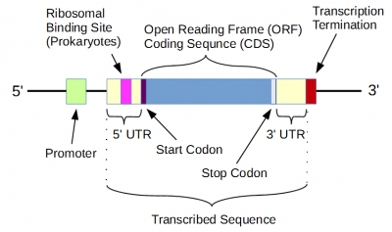
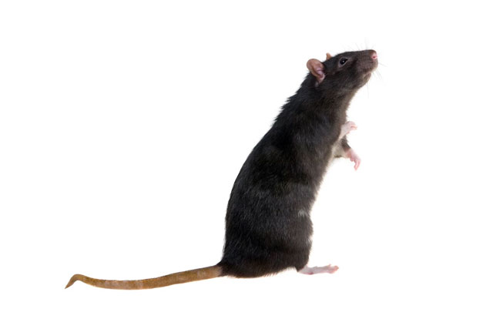
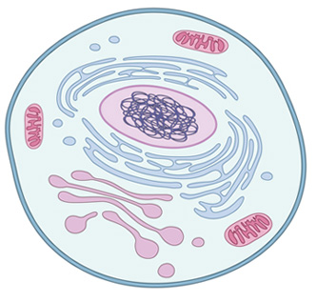
A Simple Explanation of Stop-CB1 and cb1-flx mice
Stop
loxP
Cb1 Gene
GENE
Introduction of AAV-Cre removes Cb1 gene
Introduction of AAV-Cre removes Stop cassette
Stop-Cb1
Cb1-flx

Slide 34
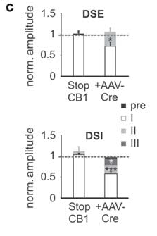
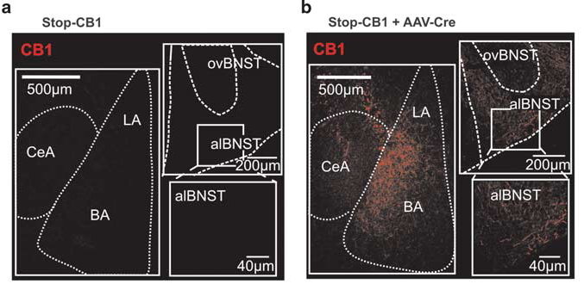
Aav-Cre rescues Cb1 expression & Activity in Stop-Cb1 Mice

Slide 35
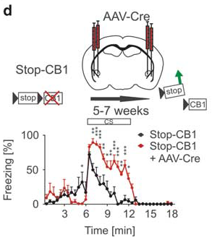
Aav-Cre rescues Cb1-induced fear response

Slide 36
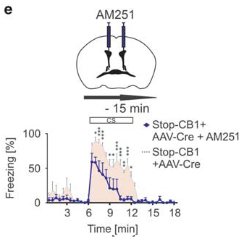
Blockade of Receptors rescued by Aav-Cre reintroduces phasic fear response

Slide 37
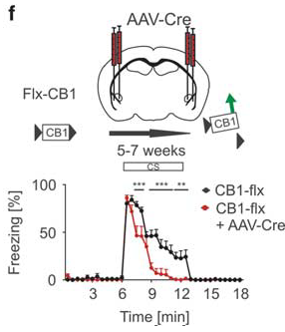
Aav-Cre induces phasic fear response in Cb1-flx mice

Slide 38
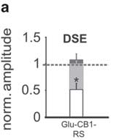
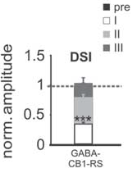
So...Cb1 Receptors are essential for the transition to prolonged fear responses
But...Are which Cb1 expressions/connections are the important ones:
…those on BA projections (glutamatergic)?
…those on CeA projections (GABAergic)?
Stop-Cb1 rescued in only Glutamate cells
Stop-Cb1 rescued in only GABA cells

Slide 39
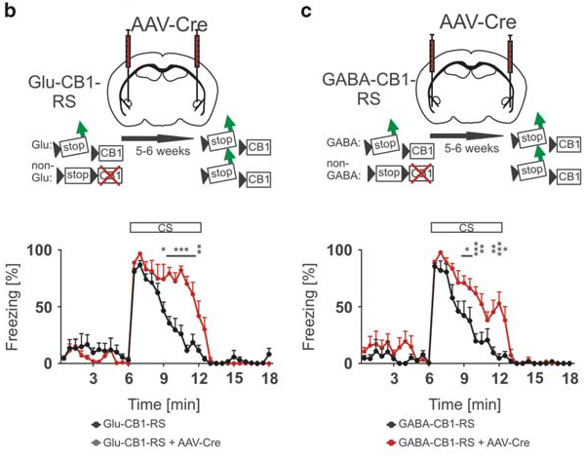
Rescue of Stop-Cb1 in Glutamatergic and Gabaergic cells partially reinstates prolonged fear responses

Slide 40
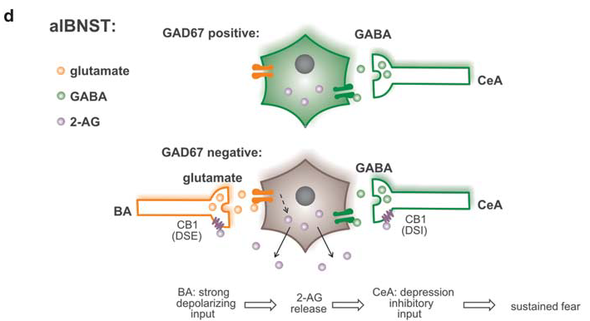
So...both connections from the BA and CeA contribute to the transition of the fear state
Cb1 Receptors exhibit stronger activity here

Slide 41
alBNST
IL
GABA
Glu
Glu
mPFC
CeA
PrL
EC
lCeA
PAG
Glu
lcCeA
Glu
“Off”
mCeA
dl/lPAG
Mc
LA
“On”
Glu
mpITC
GABA
GABA
lpITC
GABA
GABA
Glu
ACh
Glu
GABA
vlPAG
GABA
Gu
ACh
SC
GABA
BLA
HYPOTHALAMUS
Anxious &
Depressive
Behaviors

Slide 42

Cb1 Receptors
alBNST
From BA →
← From CeA
Glutamate (AMPA, NMDA) Receptors
GABA_{A} Receptor
Mild Stress Response (Startle)
HYPOTHALAMUS

Slide 43

alBNST
Prolonged Stress Response (PTSD)
HYPOTHALAMUS

Slide 44
So…
A fear/anxiety response can be fine-tuned by activation of Cb1 receptors in the BNST…
But…
What triggers the endocannabinoid release?
And…
Can a peptide help trigger an anxious state?

Slide 45
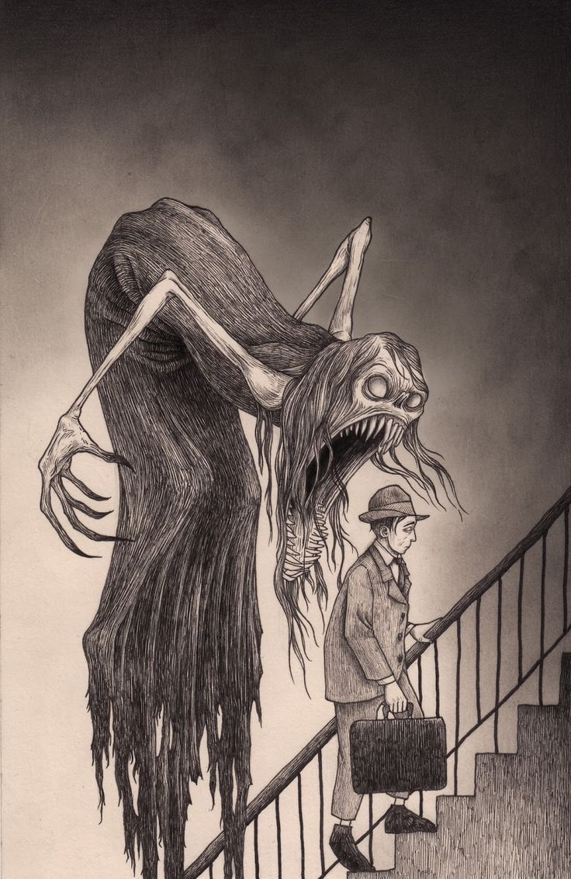
How about Orexin?
Orexin-A induces anxiety-like behavior through interactions with glutamatergic receptors in the bed nucleus of the stria terminalis of rats
Lungwitz et al. 2017

Slide 46
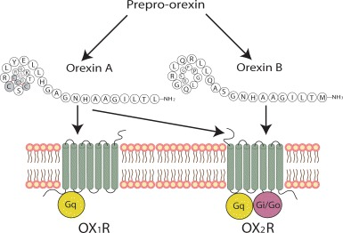
A brief introduction to Orexin…
Peptide Neurohormone
  2 Types From Single Precursor Protein
    Orexin A (Hypocretin 1) → 33 aa
      Binds Orx₁ & Orx₂ receptors with approximately equal affinity
    Orexin B (Hypocretin 2) → 28 aa
      Binds Orx₂ receptor more readily
Holland, P. and P. J. Goadsby (2007). "The hypothalamic orexinergic system: pain and primary headaches." Headache: The Journal of Head and Face Pain 47(6): 951-962.

Slide 47
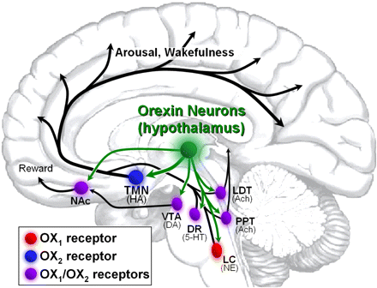
A brief introduction to Orexin…
Orexin has far-reaching influences on brain activity/behavior
BNST
Amygdala
PAG
Gotter, A. L., et al. (2012). "International Union of Basic and Clinical Pharmacology. LXXXVI. Orexin receptor function, nomenclature and pharmacology." Pharmacological reviews 64(3): 389-420.
Johnson, P. L., Samuels, B. C., Fitz, S. D., Federici, L. M., Hammes, N., Early, M. C., ... & Shekhar, A. (2012). Orexin 1 receptors are a novel target to modulate panic responses and the panic brain network. Physiology & behavior, 107(5), 733-742.

Slide 48



A brief introduction to Orexin…
Important role in regulating:
  Arousal/Wakefulness^{1,2}
  Appetite³
  Anxiety⁴
1. Hagan, J. J., et al. (1999). "Orexin A activates locus coeruleus cell firing and increases arousal in the rat." Proceedings of the National Academy of Sciences 96(19): 10911-10916.
2. Kiyashchenko, L. I., et al. (2002). "Release of hypocretin (orexin) during waking and sleep states." The journal of neuroscience 22(13): 5282-5286.
3. Sakurai, T., et al. (1998). "Orexins and orexin receptors: a family of hypothalamic neuropeptides and G protein-coupled receptors that regulate feeding behavior." Cell 92(4): 573-585.
4. Johnson, P. L., et al. (2010). "A key role for orexin in panic anxiety." Nature medicine 16(1): 111-115.

Slide 49



A brief introduction to Orexin…
Important in disorders:
  Obesity¹
  Narcolepsy²
  Addiction³
1. Kotz, C., et al. (2012). "Brain orexin promotes obesity resistance." Annals of the New York Academy of Sciences 1264(1): 72-86.
2. Siegel, J., et al. (2001). "A brief history of hypocretin/orexin and narcolepsy." Neuropsychopharmacology 25(5): S14-S20.
3. Aston-Jones, G., et al. (2009). "Role of lateral hypothalamic orexin neurons in reward processing and addiction." Neuropharmacology 56: 112-121.

Slide 50
A brief introduction to Orexin…
Why might orexin be associated with anxiety/depression?
  Activates transmitters involved in arousal/stress response¹
    Corticotripin Releasing Factor (CRF)
    Vasopresson (AVP)
What happens during anxiety/depression?
  Disrupted sleep²
  Appetite disturbances³
  Loss of energy/drive
1. Winsky-Sommerer, R., et al. (2004). "Interaction between the corticotropin-releasing factor system and hypocretins (orexins): a novel circuit mediating stress response." Journal of Neuroscience 24(50): 11439-11448.
2. Breslau, N., et al. (1996). "Sleep disturbance and psychiatric disorders: a longitudinal epidemiological study of young adults." Biological psychiatry 39(6): 411-418.
3. Leckman, J. F., et al. (1984). "Appetite disturbance and excessive guilt in major depression: use of family study data to define depressive subtypes." Archives of general psychiatry 41(9): 839-844.

Slide 51
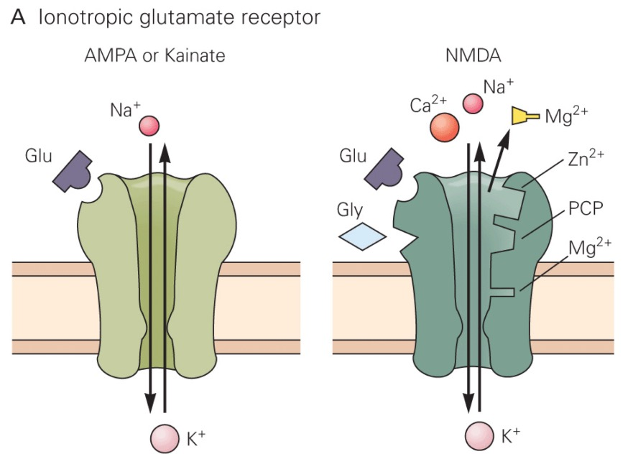
A very brief introduction to Glutamate…
The most abundant neurotransmitter in the vertebrate nervous system
  Primarily excitatory
    Some metabotropic receptors are inhibitory
The most important receptors (for this presentation) are ionotropic
  α-amino-3-hydroxy-5-methyl-4-isoxazolepropionic acid (AMPA) receptor
  N-methyl-D-aspartate (NMDA) receptor
  Kainate receptor

Slide 52
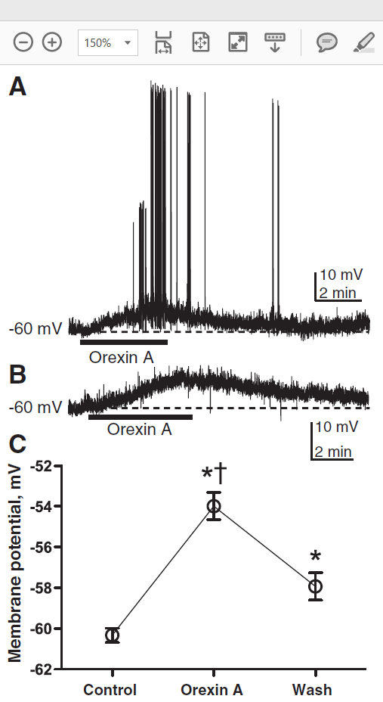
Orx-A Depolarizes BNST Neurons

Slide 53
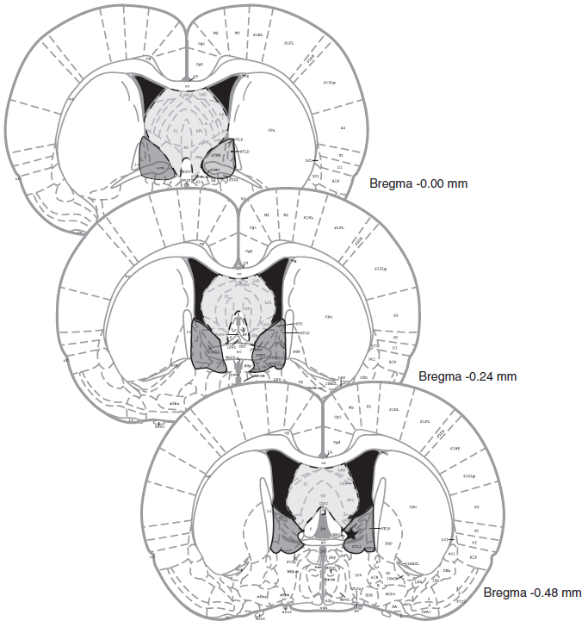

Stereotaxic Surgery
Orx-A, Vehicle, CNQX, DNQX, and/or AP5 –
30 min before behavioral testing
4+ Days
Unilateral intra-BNST or intra-Septum
CNQX – AMPA/Kainate Antagonist
DNQX – AMPA/Kainate Antagonist
AP5 – NMDA Antagonist

Slide 54


Elevated Plus Maze
5 min

Slide 55

Orx-A in the BNST increases anxious behaviors on the EPM

Slide 56


Social Interaction (SI) Test
Baseline measurements taken 48 hours before treament
5 min

Slide 57
Social Interaction (SI) Test
5 min
SI Time = Time spent engaging conspecific

Slide 58


Orx-A in the BNST decreases SI time compared to vehicle

Slide 59

Orx-A in the septum does not decrease SI Time

Slide 60

Glutamate Receptors, alone, do not explain Orx-A-Induced decrease in SI Time

Slide 61


Glutamate Activation with Orx-A contribute to SI Time Decrease

Slide 62

If We consider our Circuit…
alBNST
Mg²⁺
Orx₁ Receptor
HYPOTHALAMUS
Anxious Behavior

Slide 63

Alternatively…
alBNST
HYPOTHALAMUS
Anxious Behavior

Slide 64

Or Even…
alBNST
HYPOTHALAMUS
Anxious Behavior

Slide 65
No matter what….
Orexin has a place within the fear/anxiety circuitry…
But…
What triggers the endocannabinoid release that is required for a prolonged fear response?

Slide 66

Maybe orexin again?
Stress induces analgesia via orexin 1 receptor-initiated endocannabinoid/Cb1 signaling in the mouse periaqueductal gray
Lee et al. 2016

Slide 67

A little more information on endocannabinoids...
Synthesis pathways can be complicated
Degradation pathways are even more complicated

Slide 68


A little more information on endocannabinoids...
Not all receptors can trigger endocannabinoid production
2-AG production requires:
1) ↑ in Diacylglycerol
2) ↑ in postsynaptic Ca²⁺
G_{q} receptors can (sometimes) work
Shonesy, B. C., et al. (2015). "The initiation of synaptic 2-AG mobilization requires both an increased supply of diacylglycerol precursor and increased postsynaptic calcium." Neuropharmacology 0: 57-62.
Billington, C. and R. B Penn (2003). Signaling and regulation of G protein-coupled receptors in airway smooth muscle.

Slide 69
A little more information on endocannabinoids...
G_{q} receptors can (sometimes) work
Examples of G_{q} receptors:
mACh receptors (M₁, M₃, & M₅)
Histamine (H1) receptor
Group 1 mGluRs
5-HT₂ receptors
α₁ adrenergic receptor
V_{1A} & V_{1B} receptors
Oh yeah...and Orx₁ & Orx₂ receptors
Shonesy, B. C., et al. (2015). "The initiation of synaptic 2-AG mobilization requires both an increased supply of diacylglycerol precursor and increased postsynaptic calcium." Neuropharmacology 0: 57-62.
Billington, C. and R. B Penn (2003). Signaling and regulation of G protein-coupled receptors in airway smooth muscle.

Slide 70


Stereotaxic Surgery
Orx-A, AL-Orx-B,
SB 334867, TCX-OX2-29, Naloxone, Naltrexone, AM 251 and/or
WIN 55212-2
– intra vlPAG 5 min or i.p. 15 min before restraint stress
7+ Days
Unilateral intra-vlPAG
SB 334867 – Orx₁R Antagonist
TCX-Ox2-29 – Orx₂R Antagonist
Naloxone – Short-Lasting Opiod Receptor Antagonist
Naltrexone – Long-Lasting Opiod Receptor Antagonist
AM 251 – Cb1 Receptor Antagonist
WIN 55212-2 – Cb1 Receptor Agonist

Slide 71

Hot-Plate Test
60 s cut-off
Percentage of Maximal Possible Effect (%MPE) = 100 x (withdrawal latency_{after treatment} – withdrawal latency_{before treatment})/60 s – withdrawal latency_{before treatment})
Basically, higher number means longer withdrawal latency (less pain)
Withdrawal latency measured at:
0, 5, 10, 20, 30, 40, 50, and 60 min

Slide 72

Orx₁ receptors in the vlPAG produce analgesic responses

Slide 73

Restraint Stress
30 min
Then placed in hot-plate test

Slide 74
Restraint Stress-Induced Analgesia (SIA) increases the number of active Orexin Neurons in the LH

Slide 75
Restraint SIA increases plasma Orexin and corticosterone levels

Slide 76

Orx₁ receptors are important for Restraint SIA

Slide 77

Cb1 receptors are important for Restraint SIA

Slide 78

Orx₁ receptors in the vlPAG are important for Restraint SIA

Slide 79

Cb1 receptors in the vlPAG are important for Restraint SIA

Slide 80
Cb1 receptors in the vlPAG are important for Restraint SIA

Slide 81
So...
Orexin works with the cannabinoid system in the vlPAG to induce an analgesic response during stressful situations...
But...
What does this mean for our story?

Slide 82


Perhaps...
Orexin stimulates production of endocannabinoids in our circuit...

Slide 83

If We consider our Circuit…
alBNST
Mg²⁺
Chronic Anxious Behavior
HYPOTHALAMUS

Slide 84
alBNST
IL
GABA
Glu
Glu
mPFC
CeA
PrL
EC
lCeA
PAG
Glu
lcCeA
Glu
“Off”
mCeA
dl/lPAG
Mc
LA
“On”
Glu
mpITC
GABA
GABA
lpITC
GABA
GABA
Glu
ACh
Glu
GABA
vlPAG
GABA
Gu
ACh
SC
GABA
BLA
HYPOTHALAMUS
Anxious &
Depressive
Behaviors

Slide 85
Things to Consider...
Orexin is only 1 consideration for endocannabinoid synthesis...
For example:
Metabotropic glutamate receptors have been found in the BNST
mGluR2/3¹
mGluR7²
mGluR5³
Muly, E. C., et al. (2007). "Group II metabotropic glutamate receptors in anxiety circuitry: correspondence of physiological response and subcellular distribution." J Comp Neurol 505(6): 682-700.
Masugi-Tokita, M., et al. (2016). "Metabotropic Glutamate Receptor Subtype 7 in the Bed Nucleus of the Stria Terminalis is Essential for Intermale Aggression." Neuropsychopharmacology 41(3): 726-735.
Grueter, B. A., et al. (2008). Metabotropic Glutamate Receptor 5 (mGluR5) Antagonism Prevents Cocaine-Induced Disruption of Postsynaptically Maintained mGluR5-Dependent Long-Term Depression." The Journal of Neuroscience 28(37): 9261.

Slide 86
Take Home Messages or Things to Think about
Is the fear/anxiety gradient partially explained through amygdalar & BNST circuitry?
1) Endocannabinoids in the alBNST
Phasic Fear → Prolonged Fear
2) Orexin in the BNST
Orexin → Orx₁R → ↑ Anxiety
3) Orexin/Endocannabinoid Interaction
Orexin/Endocannabinoid → Orx₁R/Cb1-R → ↓ Pain (in vlPAG)

Slide 87
References
Aston-Jones, G., et al. (2009). "Role of lateral hypothalamic orexin neurons in reward processing and addiction." Neuropharmacology 56: 112-121.
Başoğlu, M. and S. Mineka (1992). "The role of uncontrollable and unpredictable stress in post-traumatic stress responses in torture survivors.“
Billington, C. and R. B Penn (2003). Signaling and regulation of G protein-coupled receptors in airway smooth muscle.
Breslau, N., et al. (1996). "Sleep disturbance and psychiatric disorders: a longitudinal epidemiological study of young adults." Biological psychiatry 39(6): 411-418.
Etkin, A. and T. D. Wager (2007). "Functional neuroimaging of anxiety: a meta-analysis of emotional processing in PTSD, social anxiety disorder, and specific phobia." American Journal of Psychiatry 164(10): 1476-1488.
Foa, E. B., et al. (1992). "Uncontrollability and unpredictability in post-traumatic stress disorder: an animal model." Psychological bulletin 112(2): 218.
Gotter, A. L., et al. (2012). "International Union of Basic and Clinical Pharmacology. LXXXVI. Orexin receptor function, nomenclature and pharmacology." Pharmacological reviews 64(3): 389-420.
Grueter, B. A., et al. (2008). Metabotropic Glutamate Receptor 5 (mGluR5) Antagonism Prevents Cocaine-Induced Disruption of Postsynaptically Maintained mGluR5-Dependent Long-Term Depression." The Journal of Neuroscience 28(37): 9261.
Hagan, J. J., et al. (1999). "Orexin A activates locus coeruleus cell firing and increases arousal in the rat." Proceedings of the National Academy of Sciences 96(19): 10911-10916.
Holland, P. and P. J. Goadsby (2007). "The hypothalamic orexinergic system: pain and primary headaches." Headache: The Journal of Head and Face Pain 47(6): 951-962.
Janak, P. H. and K. M. Tye (2015). "From circuits to behaviour in the amygdala." Nature 517: 284.
Johnson, P. L., Samuels, B. C., Fitz, S. D., Federici, L. M., Hammes, N., Early, M. C., ... & Shekhar, A. (2012). Orexin 1 receptors are a novel target to modulate panic responses and the panic brain network. Physiology & behavior, 107(5), 733-742.
Johnson, P. L., et al. (2010). "A key role for orexin in panic anxiety." Nature medicine 16(1): 111-115.
Kiyashchenko, L. I., et al. (2002). "Release of hypocretin (orexin) during waking and sleep states." The journal of neuroscience 22(13): 5282-5286.
Kotz, C., et al. (2012). "Brain orexin promotes obesity resistance." Annals of the New York Academy Sciences 1264(1): 72-86.
Lange, M., et al. (2016). "Cannabinoid CB1 receptors in distinct circuits of the extended amygdala determine fear responsiveness to unpredictable threat." Molecular psychiatry.
Leckman, J. F., et al. (1984). "Appetite disturbance and excessive guilt in major depression: use of family study data to define depressive subtypes." Archives of general psychiatry 41(9): 839-844.
Lee, H.-J., et al. (2016). "Stress induces analgesia via orexin 1 receptor-initiated endocannabinoid/CB1 signaling in the mouse periaqueductal gray." Neuropharmacology 105: 577-586.
Lungwitz, E. A., et al. (2012). "Orexin-A induces anxiety-like behavior through interactions with glutamatergic receptors in the bed nucleus of the stria terminalis of rats." Physiology & Behavior 107(5): 726-732.
Masugi-Tokita, M., et al. (2016). "Metabotropic Glutamate Receptor Subtype 7 in the Bed Nucleus of the Stria Terminalis is Essential for Intermale Aggression." Neuropsychopharmacology 41(3): 726-735.
Mechoulam, R., et al. (2014). "Early phytocannabinoid chemistry to endocannabinoids and beyond." Nature Reviews Neuroscience 15: 757.
Muly, E. C., et al. (2007). "Group II metabotropic glutamate receptors in anxiety circuitry: correspondence of physiological response and subcellular distribution." J Comp Neurol 505(6): 682-700.
Papp, M., et al. (1991). "An animal model of anhedonia: attenuation of sucrose consumption and place preference conditioning by chronic unpredictable mild stress." Psychopharmacology 104(2): 255-259.
Puente, N., Elezgarai, I., Lafourcade, M., Reguero, L., Marsicano, G., Georges, F., ... & Grandes, P. (2010). Localization and function of the cannabinoid CB1 receptor in the anterolateral bed nucleus of the stria terminalis. PloS one, 5(1), e8869.
Pryce G, Baker D. Potential control of multiple sclerosis by cannabis and the endocannabinoid system. CNS Neurol Disord Drug Targets 11: 624-641.
Sakurai, T., et al. (1998). "Orexins and orexin receptors: a family of hypothalamic neuropeptides and G protein-coupled receptors that regulate feeding behavior." Cell 92(4): 573-585.
Shonesy, B. C., et al. (2015). "The initiation of synaptic 2-AG mobilization requires both an increased supply of diacylglycerol precursor and increased postsynaptic calcium." Neuropharmacology 0: 57-62.
Siegel, J., et al. (2001). "A brief history of hypocretin/orexin and narcolepsy." Neuropsychopharmacology 25(5): S14-S20.
Tovote, P., et al. (2015). "Neuronal circuits for fear and anxiety." Nature Reviews. Neuroscience 16(6): 317.
Willner, P. (1997). "Validity, reliability and utility of the chronic mild stress model of depression: a 10-year review and evaluation." Psychopharmacology 134(4): 319-329.
Winsky-Sommerer, R., et al. (2004). "Interaction between the corticotropin-releasing factor system and hypocretins (orexins): a novel circuit mediating stress response." Journal of Neuroscience 24(50): 11439-11448.

